Slide 1
Unordered list

Slide 2
Agenda
Unordered list
Sample output
Unordered List implementation

Slide 3
Unordered list
The list created with bullet points or pointing arrows and with no numbering or alphabets are called Unordered list.
Example:
List with bullet pointer
List with circle pointer
List with square pointer
Syntax:
<ul> // Used to hold all the list of elements together with bullet points by default
<li> Item 1</li>
<li> Item 2</li>
</ul>

Slide 4
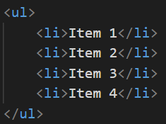
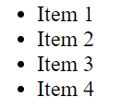
Sample output

Slide 5
Unordered List implementation
Let’s see Unordered list implementation.

Slide 6
Summary
Unordered list is shown with bullet points by default.
We have seen practical implementation of the same.
DO NOT WRITE ANYTHING
HERE. LEAVE THIS SPACE FOR
WEBCAM

Slide 7
Thank You

